Slide 1

The Atlantic Multidecadal Oscillation (P8)
Big Data & Cloud Computing for Oceanography

Slide 2
OUTLINE
Physical phenomenon
AMO Index
Dataset
SST data analysis
Mean forecast
Power spectrum
PCA
Standard deviation
Pressure analysis
Conclusion
Notes:
1 - 2 - 3 : Maelle
4.1 : Karel
4.2 - 4.3 - 4.4 : Tobias
5 : Khalid
6 : Karel

Slide 3
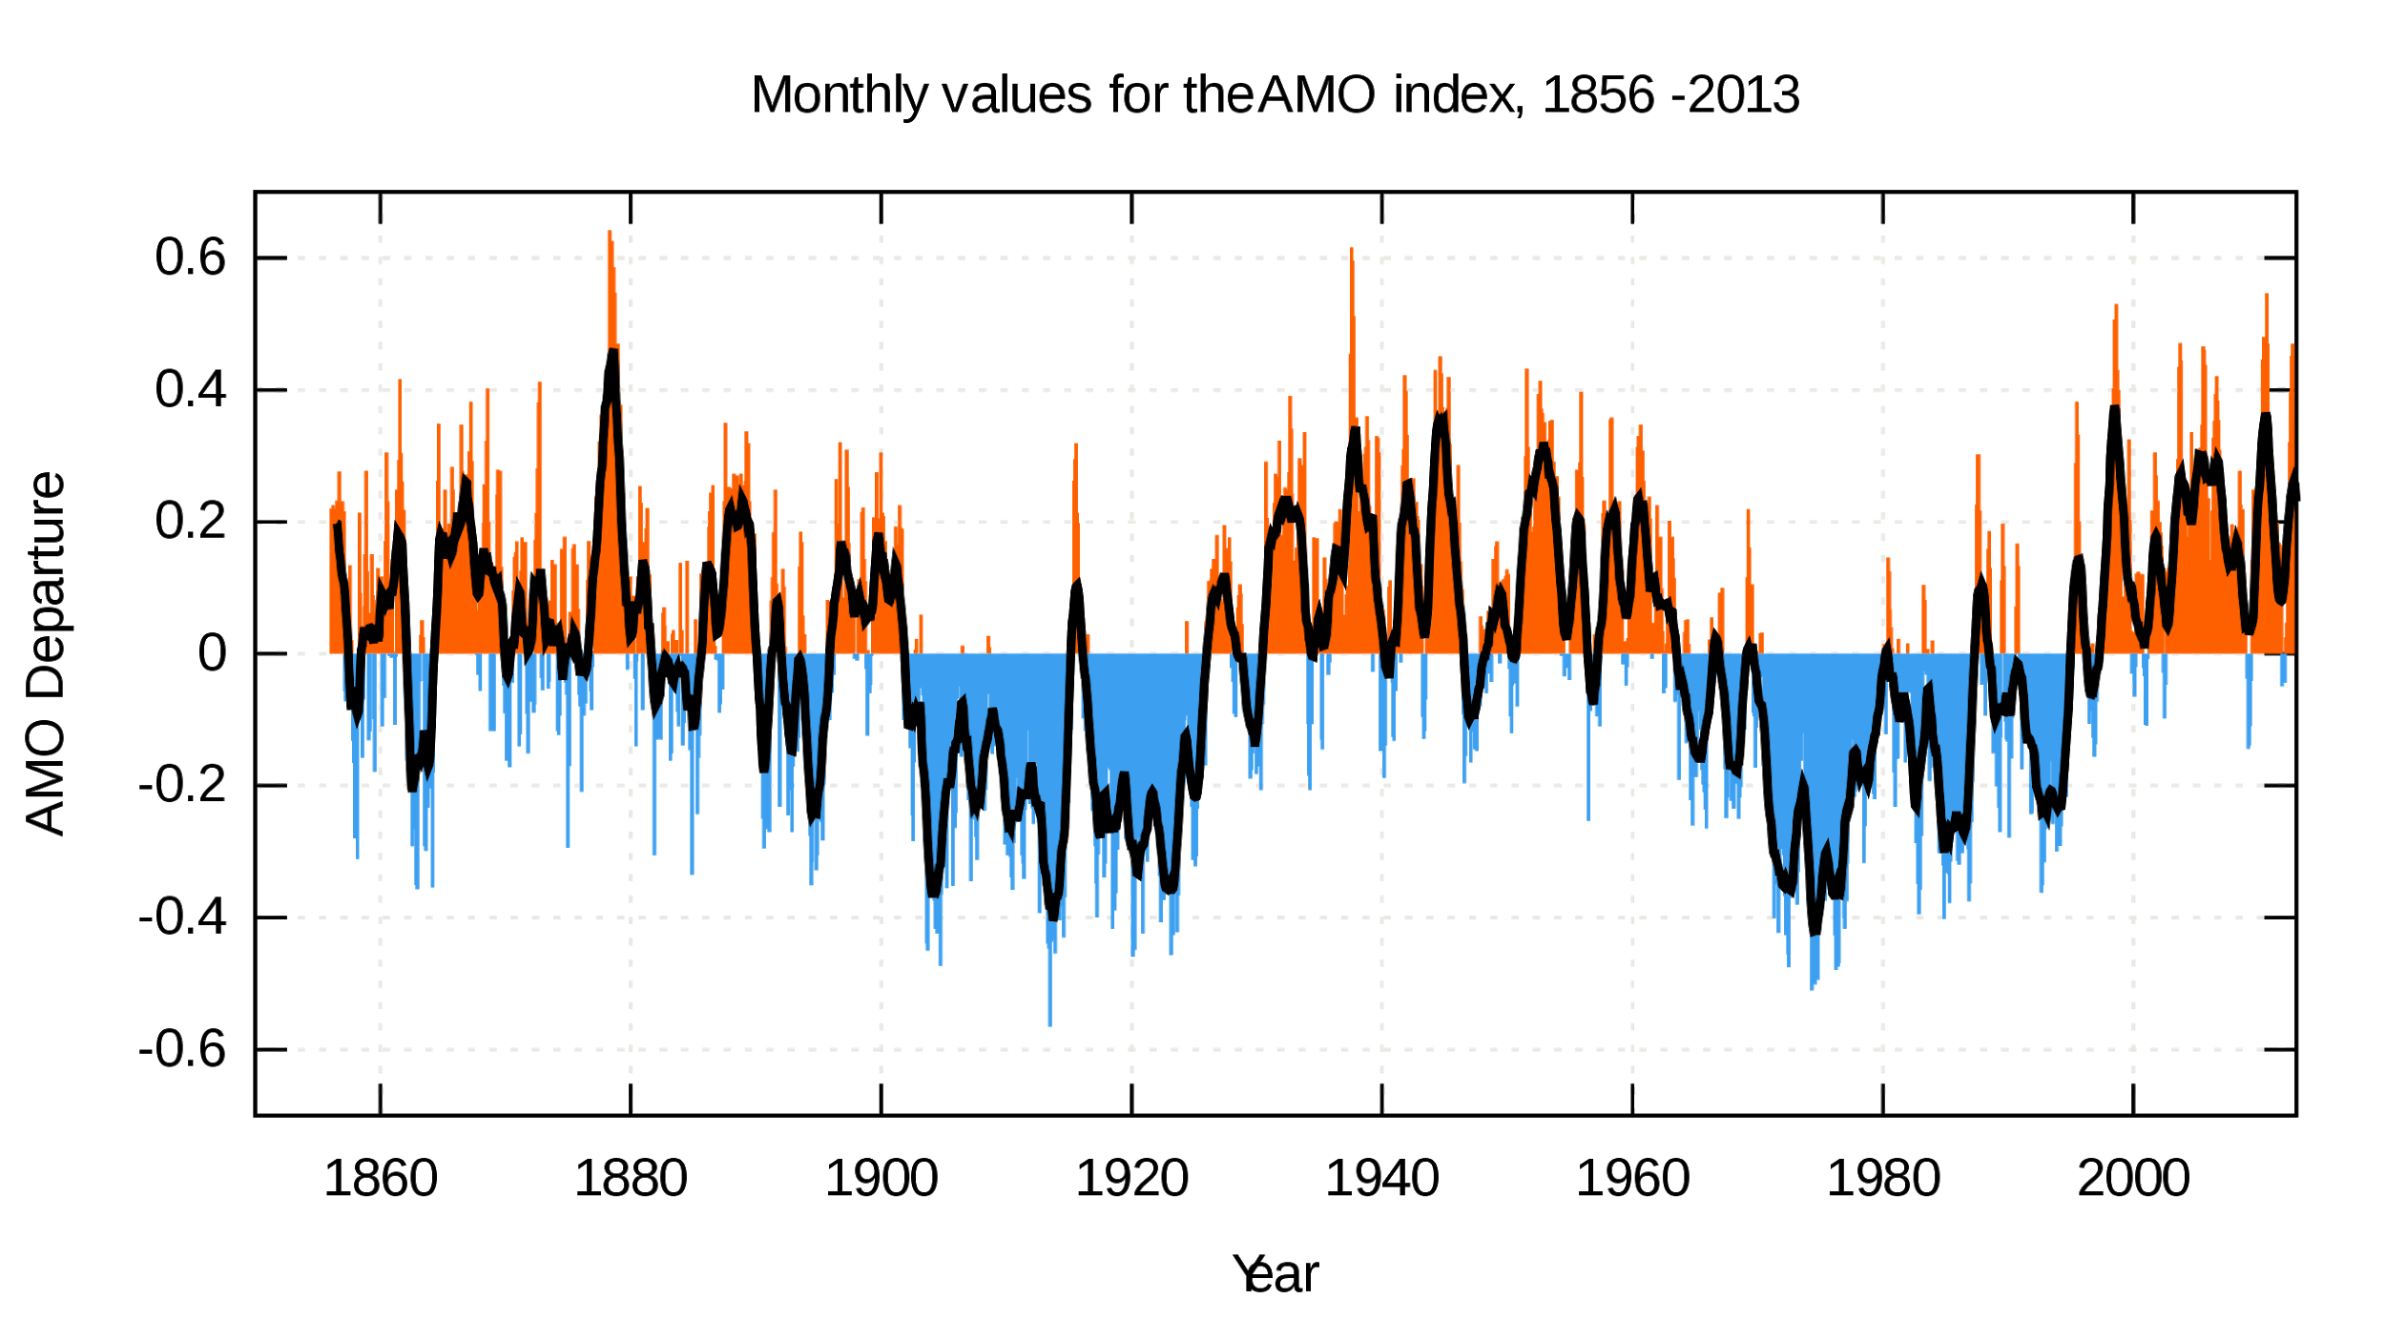
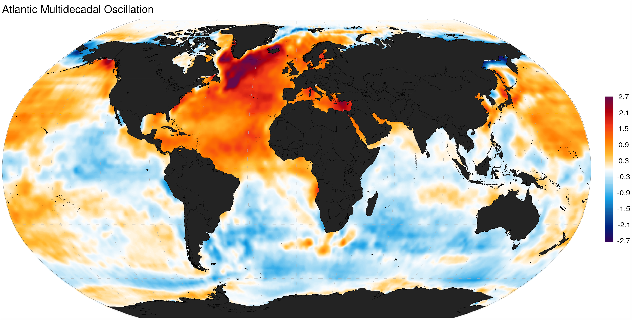
P8 [SC] → The Atlantic
Multidecadal Oscillation (North Atlantic)
80W <= lon <= 0E
0N <= lat <= 65N
~150 years of data
The Atlantic Multidecadal Oscillation is a low-frequency climate cycle, associated with the modulation of the sea surface temperature over the North Atlantic. The cold/warm phases may last for 20-40 years. It has wide impacts on the climate of the Northern Hemisphere.
You will use model data from the CMIP6 archive, introduced in the slide for Project 7, to calculate the Atlantic Multidecadal Oscillation index in future climate projections. You can look at differences in the index calculated using several simulations from the same model, and the spatial patterns of variability. If you have time, you could compare with a second set of simulations from a different model in the CMIP6 archive.

Slide 4
4. SST data analysis

Slide 5
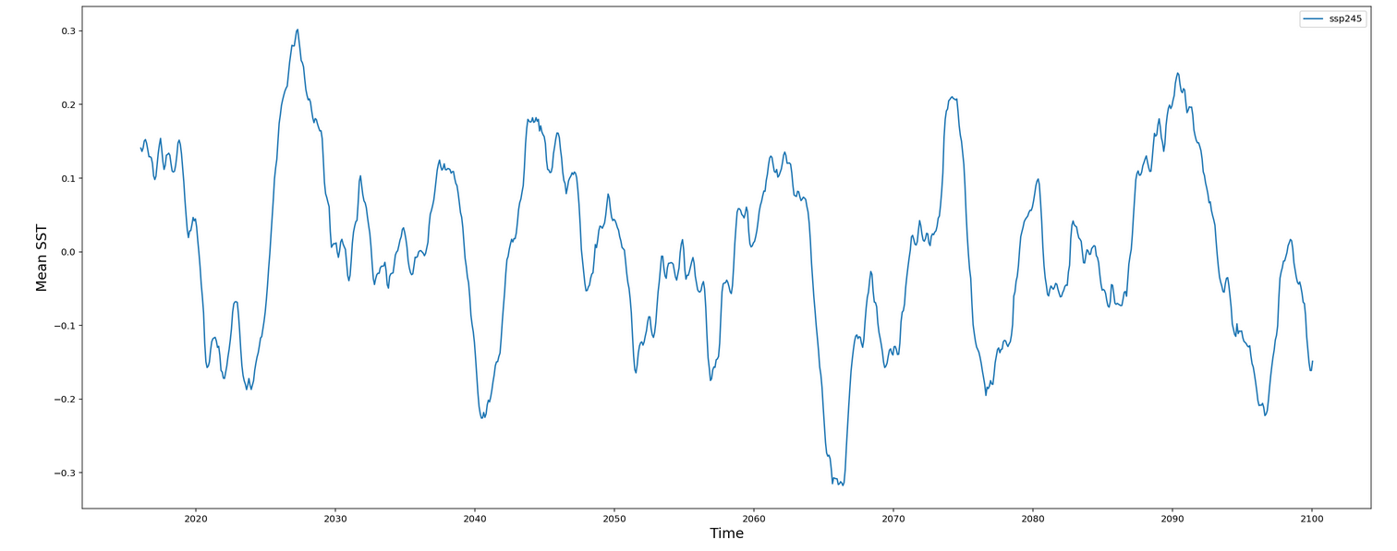
(yr)

Slide 6
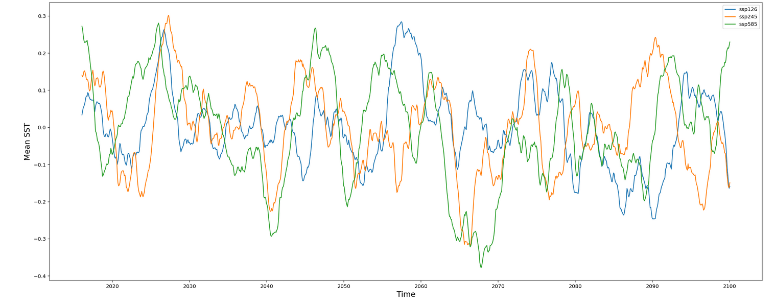

Slide 7
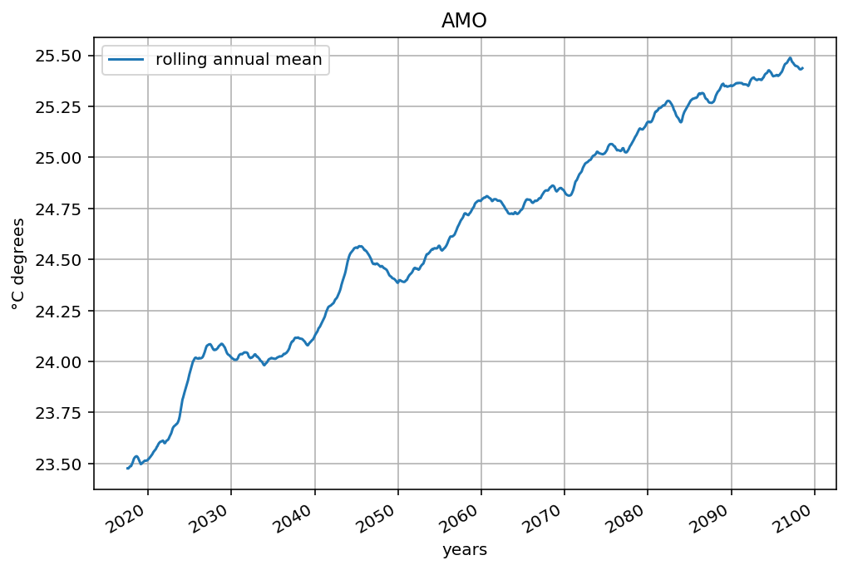
Mean forecast 2015-2100
- Temperature is linearly
increasing due to Global
Warming

Slide 8
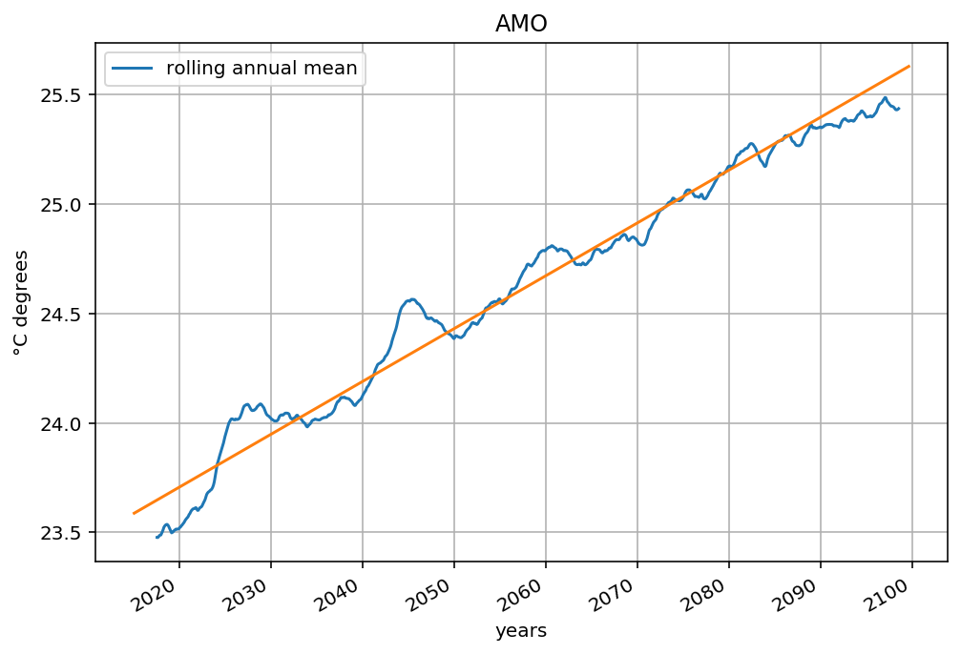
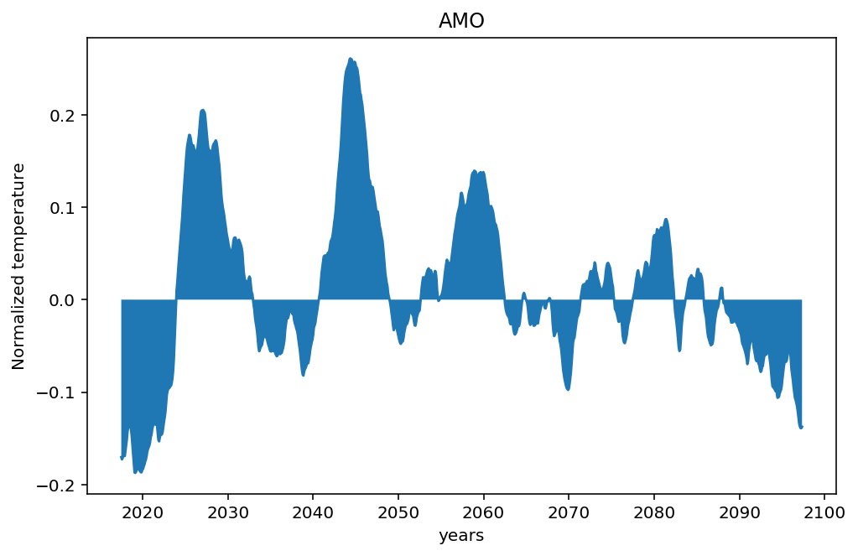

Atlantic multidecadal oscillations
Linear regression Global warming effect removed

Slide 9
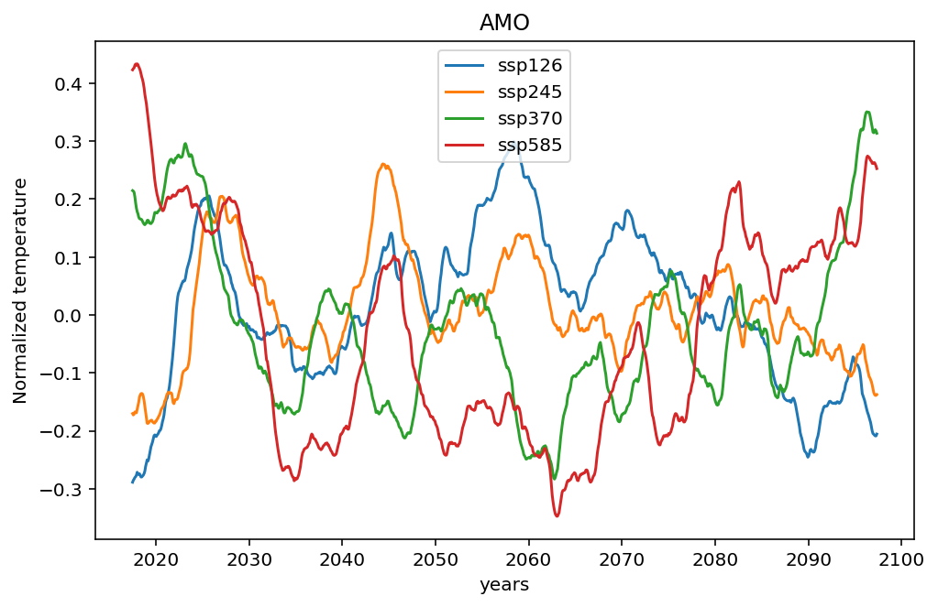
Comparing 5 experiences of the same model
-Different initial conditions
-Similar oscillations

Slide 10
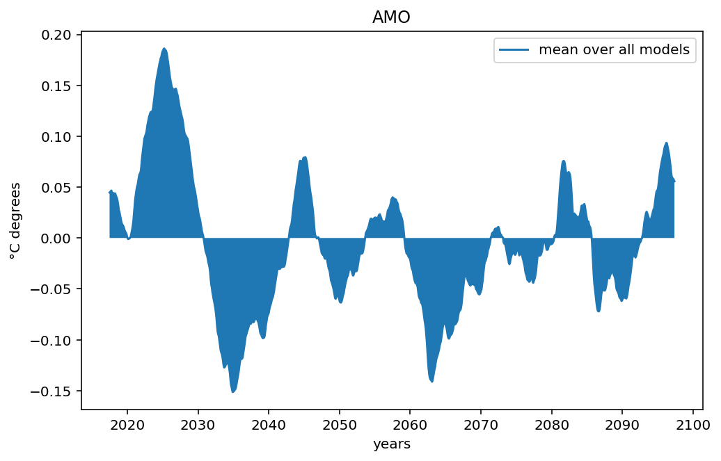
Comparing 5 experiences of the same model
Mean temperature over
previously calculated
experiments

Slide 11
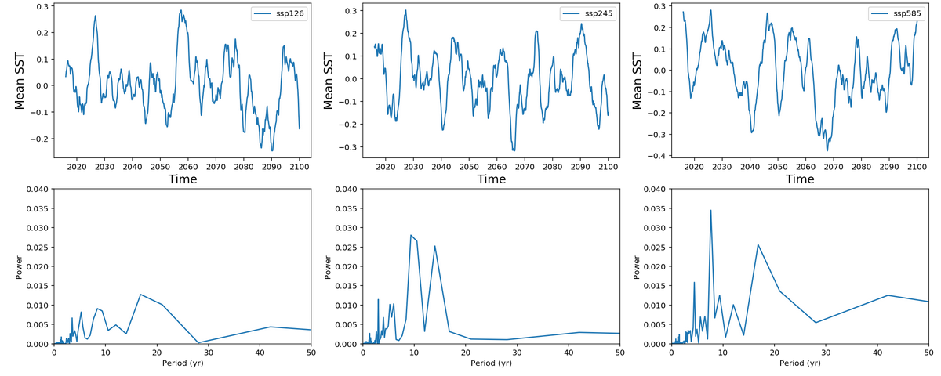
4.2. Power spectrum - Scenario MIP

Slide 12
4.3. PCA

Slide 13
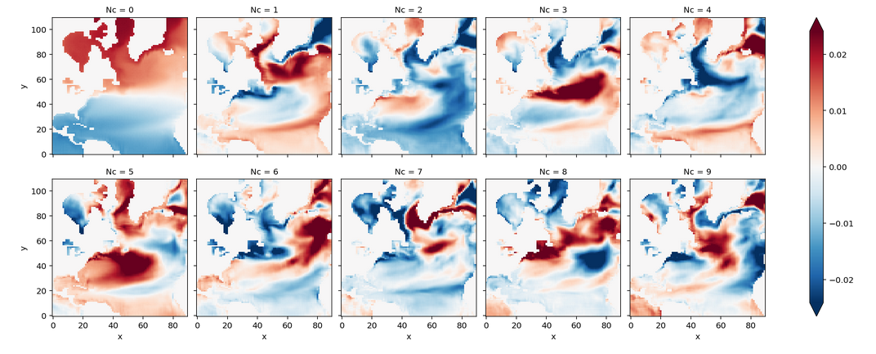
4.3. Principal Component Analysis

Slide 14
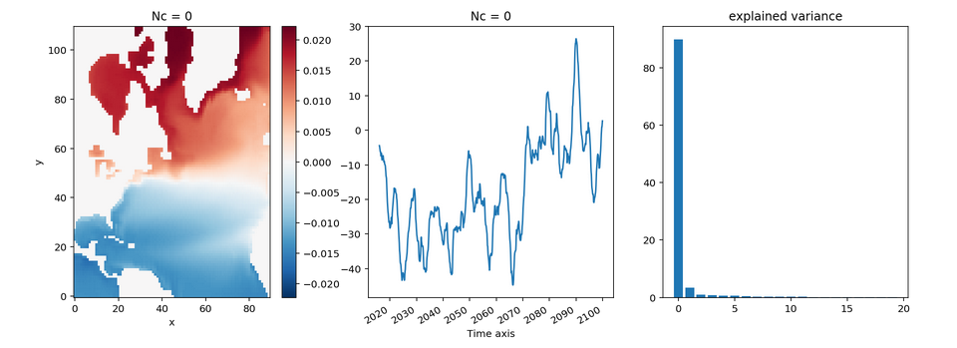
4.3. Principal component (ssp245)
(yr)

Slide 15
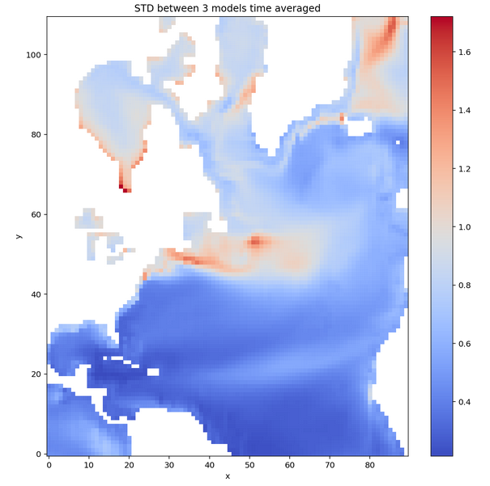
4.4. Uncertainty by region

Slide 16
5. Pressure analysis

Slide 17
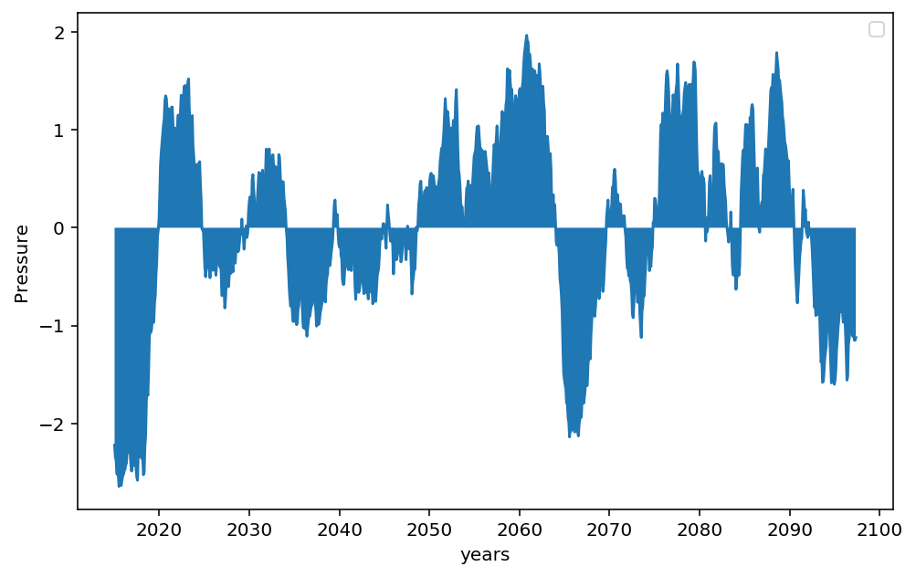
Pressure
-Pressure’s value
is predicted to
go down
between 2020 and
2060

Slide 18
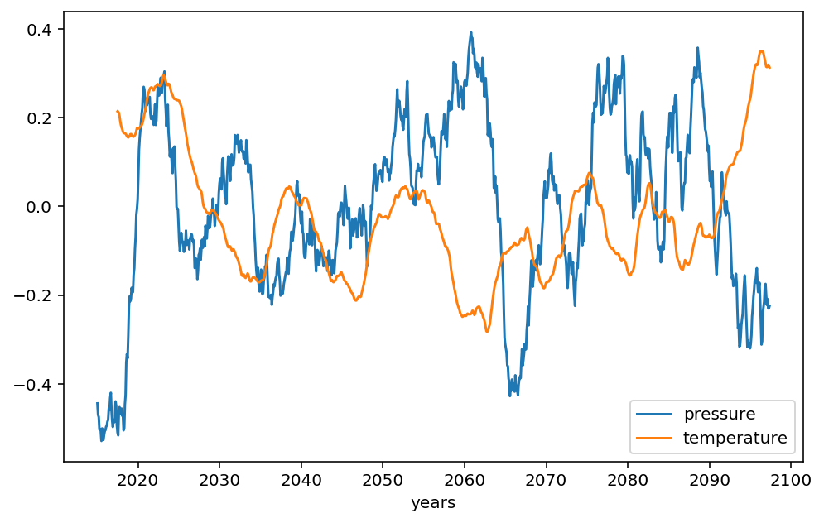
Pressure and temperature comparison
-Pressure decreases when
sea surface temperature
increases during the
oscillations

Slide 19
6. Conclusion

